Slide 1
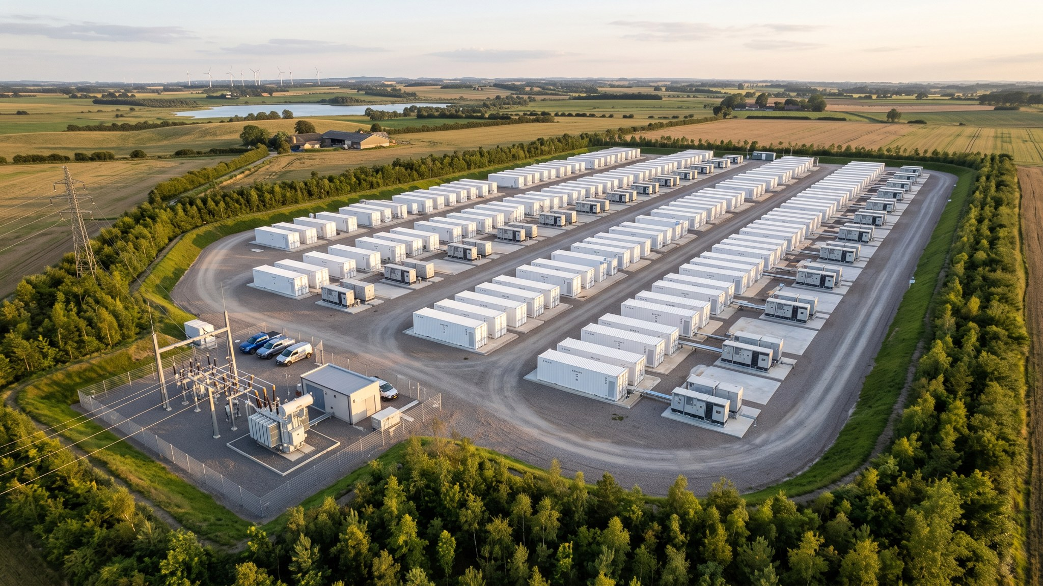
WEYLAND ENERGY
Fenwick Battery Storage
Revenue stack analysis · September 2026

Slide 2
Headlines
136
12.5 m
64 m
2029
EUR k/MW/a, avg. first 10 years
EUR EBITDA p.a. (avg.)
EUR capex
target COD
• Base case built on two independent market forecasts (averaged)
WEYLAND ENERGY · Fenwick – Revenue Stack
2

Slide 3
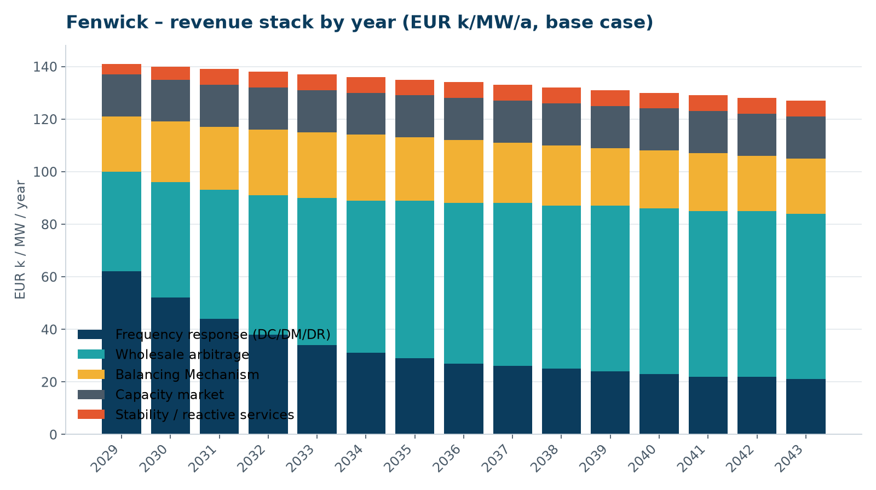
How the stack evolves
• Frequency response dominates early years
• Saturation brings Dynamic Containment prices down
• Wholesale arbitrage grows with renewable share
WEYLAND ENERGY · Fenwick – Revenue Stack
3
Notes:
Explain why we do not count on DC prices staying high – more than 5 GW of BESS is in the queue.

Slide 4
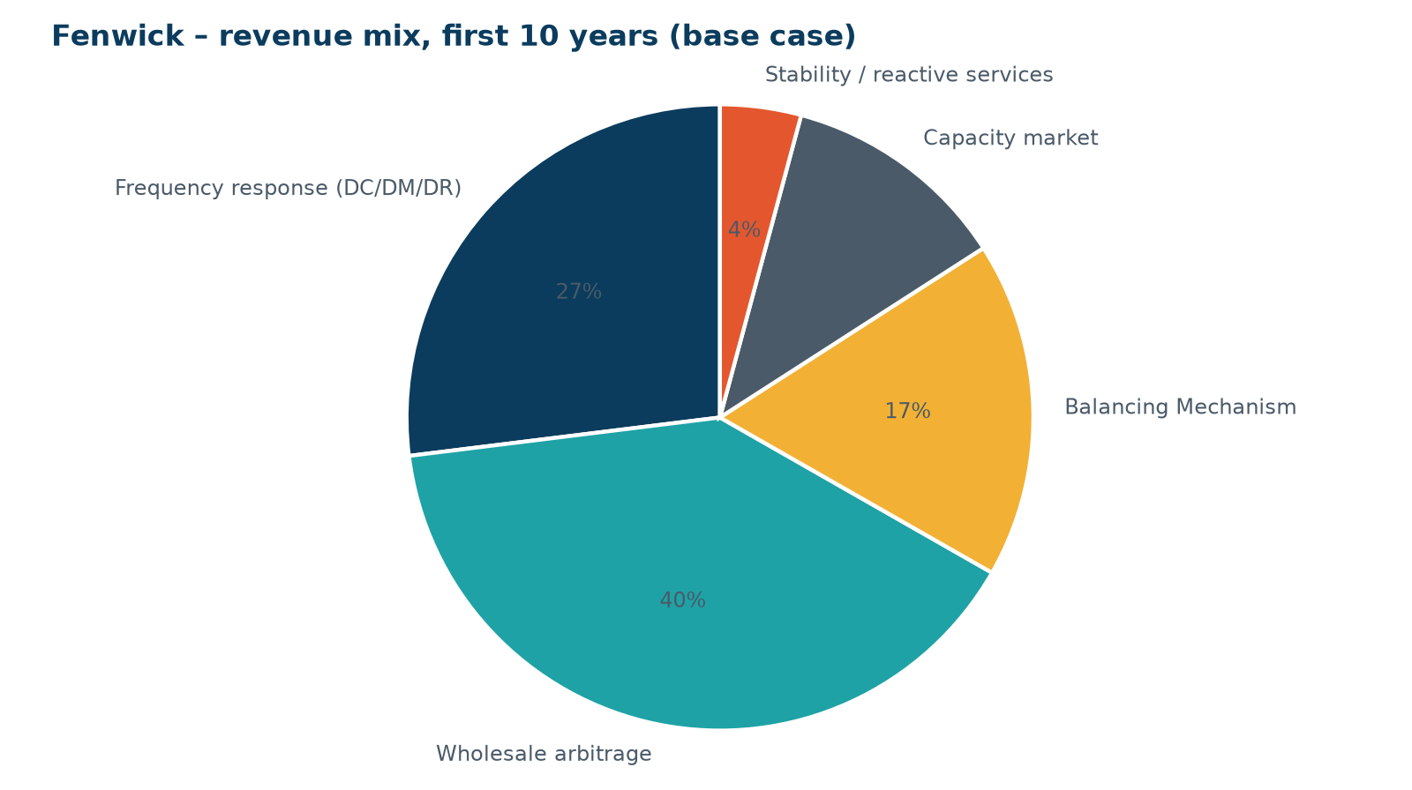
Revenue mix (first 10 years)
• ~ 30 % frequency response
• ~ 35 % wholesale arbitrage
• Capacity market as stable floor
WEYLAND ENERGY · Fenwick – Revenue Stack
4

Slide 5
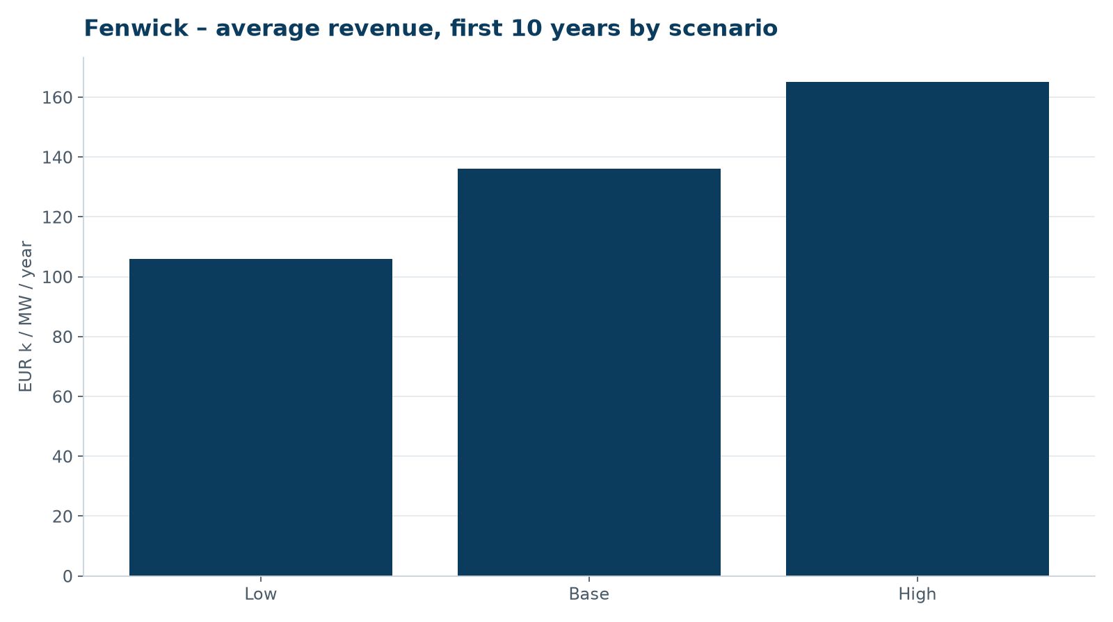
Scenarios
• Low case: ancillary saturation + non-firm grid
• High case: gas price volatility
WEYLAND ENERGY · Fenwick – Revenue Stack
5

Slide 6
Route to market
Option | Pros | Cons
Merchant via optimiser | Full upside | Volatile cash flow, harder to finance
Floor + upside share | Bankable floor, keeps upside | Floor provider takes 15–25 % of upside
Tolling agreement (7 yrs) | Fixed revenue, best for debt | Gives away most upside
WEYLAND ENERGY · Fenwick – Revenue Stack
6

Slide 7
Next steps
• Request indicative floor offers from three optimisers (Q4 2026)
• Update after grid offer (expected Q2 2027)
• Include grid-forming / stability revenues as upside only
WEYLAND ENERGY · Fenwick – Revenue Stack
7

Slide 8
WEYLAND ENERGY
Questions
Kwame Mensah · Liam McAllister

